Slide 1
Overview of Indian Machine
Tools Industry

Slide 2
Indian Machine Tools Industry – Overview
Current Scenario
Indian Machine Tools Industry is valued at CHF 1.8 Bn in 2017-18 and globally ranks 10th in production and 8th in consumption. The Machine Tools industry in India is expected to reach CHF 2.6 Bn by 2020 at CAGR of 12.6%
There are currently about 1,000 units in production of machine tools and of these, around 25 in the large-scale sector accounts for 70% of the turnover and the rest are in the MSME sector
Metal cutting machine tools account for 87% of the total machine tool production of which 66% is CNC machines
Source: Indian Machine Tool Manufacturers' Association – June 2019, IMTMA Annual Report 2017-18, www.oemupdate.com/industry-analysis/made-in-india-machine-tools-for-aerospace-and-defence

Slide 3
Indian Machine Tools Industry – Industry Composition
Metal Cutting
CNC
The industry comprises ~200 manufacturers in the organized sector and ~400 in the small ancillary sector
Large players comprise about 25%, and 75% is dominated by small manufacturers
The machine tools market in India is highly fragmented with the presence of various small, medium, and large suppliers, which include international and regional player
Milling, Turning, Threading,
Grinding, Filing, etc.
Non-CNC
Machine Tools
Forging, bending, rolling,
pressing, etc
CNC
Metal Forming
Non-CNC
Organized
33%
Unorganized
67%
Market Share
ISO Certified
75%
Non-Certified
25%
Source: Indian Machine Tools Industry Report – Italian Trade Commission

Slide 4
Indian Machine Tools Industry
Government Policies
Machine Tools Production in India
– by Value (CHF Mn)
100% foreign direct investment (FDI) is allowed
Manufacturers are exempt from obtaining an industrial license for developing tools
Import duties have been consistently reduced to promote increased import and usage of machine tools
Exports are being recognized as a national priority by all union and state government agencies
CNC
Non-CNC
CNC
Non-CNC
Metal Cutting
654.2
47.4
654.2
47.4
Metal Forming
15.7
66.6
15.7
66.6
2016-17
2017-18
Source: Indian Machine Tools Industry Report – Italian Trade Commission

Slide 5
Indian Machine Tools Industry - Drivers
Automotive Sector: The key demand driver
Leading global car makers establishing their manufacturing bases in India. Eg: Kia Motors invested CHF 2 Bn for its manufacturing unit in India
Rise of Electric Vehicles to play a major role as the EV market size to cross CHF 2 Bn by FY 2023
Aerospace and Defense Sector
Indian government plans to spend CHF 130 Bn over the next five years in order to achieve self reliance in defense production
India is estimated to become the third-largest aviation market in the world by 2025, and will likely need nearly 1,500 new commercial aircraft by 2030
Additive Manufacturing
Indian market is positive about the growth of the additive manufacturing technology in the near future
The global additive manufacturing market is estimated to grow at a CAGR of 17.7 % and is expected to reach CHF 36.61 Bn by 2027 from the current CHF 8.4 Bn, while the Indian AM market alone is expected to be worth CHF 80 million dollars by 2021
Source: Indian Machine Tool Manufacturers' Association – June 2019, IMTMA Annual Report 2017-18, www.oemupdate.com/industry-analysis/made-in-india-machine-tools-for-aerospace-and-defence

Slide 6
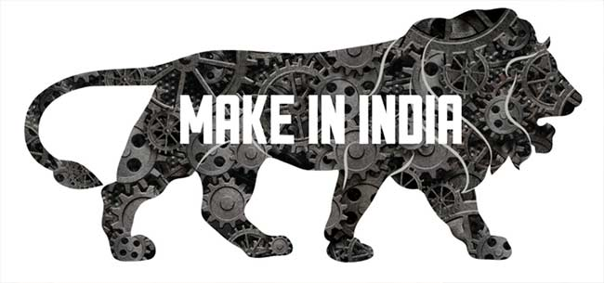
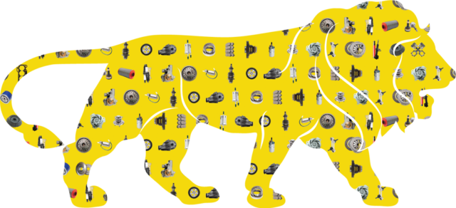
Indian Machine Tools Industry – Initiatives & Challenge
Make in India
National Capital Goods Policy 2016
Demand – Supply Gap
As the production of machine tools is not in line with the consumption, India relies heavily on import. India ranks 8th in consumption and 10th in production, giving rise to the demand and supply gap in the machine tools segment.
Typically, 60-70% of the Indian Machine Tools cater to the automotive industry so other industry segments must rely on import. Consequently, 30-40% machine tools are imported.
Government of India floated the ‘Make in India’ initiative with a vision to make the country a manufacturing hub
The initiative gives great opportunity for the sector to grow at 20-25% annually
The National Capital Goods Policy is aimed at making the Indian capital goods sector globally competitive
The policy envisages increasing production of capital goods from CHF 43 Bn in 2016-17 to CHF 100 Bn by 2025
Source: Financial Express, www.mtwmag.com/enabling-the-make-in-india-dream

Slide 7
Indian Machine Tools Industry – Opportunities
Growing Demand
Growth Opportunities
Growth in the manufacturing sector across emerging markets, coupled with growing demand for machining tools in automotive, defense, and aerospace, will elevate the industry
Rising automation and use of advanced technology in manufacturing and construction industry to increase demand for machine tools
There is a subsequent rise in implementation of machine tool technology in lathe, milling, laser, grinding, and welding machines due to extensive use of technologically advanced CNC machines
Automobile, auto component and capital goods industries form a major market for machine tools in India
Machine tools also find their usage in the engineering, steel, glass, ceramics and refractory segments, owing to the government’s focus on construction, infrastructure and low-cost housing
Aerospace sector is the fastest-growing application because of growing use of multi-tasking machines in the aerospace industry
As all these industries require high-end sophisticated and precision machines, the machine tools market is expected to move towards innovation
Source: Indian Machine Tools Industry Report – Italian Trade Commission

Slide 8
Indian Machine Tools Industry – Automotive
Automotive industry is a key driver of macroeconomic growth and technological advancement in India
India is expected to be the world's third-largest automotive market in terms of volume by 2026
India is the largest tractor manufacturer, second-largest bus manufacturer and third-largest heavy trucks manufacturer in the world
The Indian automotive aftermarket is estimated to reach CHF 16.5 Bn by 2021
The Indian auto-components industry has grown by 18.3% Y-o-Y to reach CHF 51.2 Bn in 2017-18
The auto component market is the key driving sector,
accounting for about 40% of the machine tools industry
Source: Indian Machine Tools Industry Report – Italian Trade Commission

Slide 9
Indian Machine Tools Industry – Aerospace
The Aerospace and Defence market in India is estimated to reach about CHF 70 Bn by 2030
India is expected to become the third-largest aviation market globally by 2025, after China and the US
India’s Maintenance, Repair and Overhaul (MRO) segment is estimated to reach CHF 2.6 Bn by 2020, rising from CHF 1.2 Bn in 2010
Air transport sector (including air freight) has attracted FDI worth CHF 2 Bn during April 2000-June 2019
Investments of CHF 6-7 Bn are expected in India’s airport infrastructure between 2018-2023
Aerospace sector is giving more opportunities to Indian machine tool builders, but the technologies demanded by manufacturers are not available with the machine tool industry. So, there is a lot of R&D involved
Source: Indian Machine Tools Industry Report – Italian Trade Commission, OEM Update – Sep 2018

Slide 10
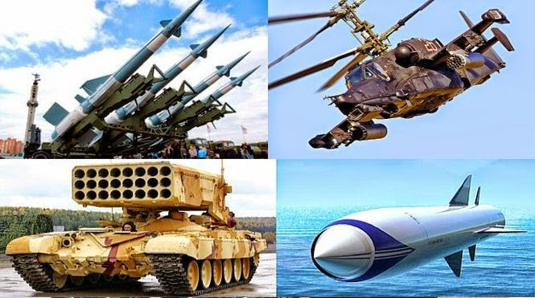
Indian Machine Tools Industry – Defense
India has the world’s third-largest armed forces and the country’s defense spending is estimated to reach CHF 620 Bn by 2022
The total budget sanctioned for the Indian military for the FY 2018-19 is CHF 62.8 Bn, accounting for 12.1% of the total Union Government expenditure for 2018-19
Defense production by Ordnance Factory Board (OFBs) and Defense Public Sector Undertakings (DPSUs) increased to CHF 9.12 Bn in 2017-18
Indian government encourages private investment in both civil and defense aerospace sectors, with 100% FDI allowed under the automatic route for most activities
Privatization of Indian defense sector in 2017-18 has opened avenues for machine tools industry to produce more advanced technology and artillery
Source: Indian Machine Tools Industry Report – Italian Trade Commission, OEM Update – Sep 2018

Slide 11
THANK YOU

