Slide 1

Globally
active
EASE OF DOING BUSINESS IN India
PRACTICE REPORT FROM Legal & tax perspective
Seema Bhardwaj
Zurich,

Slide 2


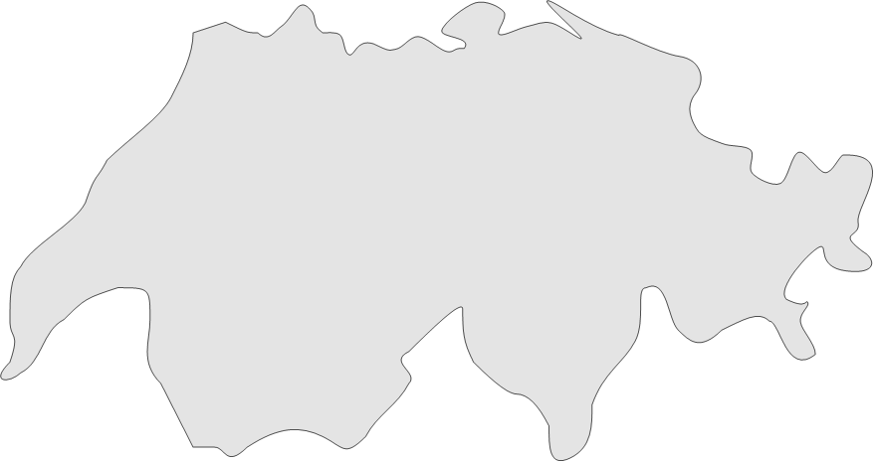


Rödl & Partner in Germany and Switzerland
Nuremberg*
Ansbach
Bamberg
Bayreuth
Berlin*
Bielefeld
Chemnitz
Cologne
Dresden
Eschborn
Fuerth
Hamburg
Hannover
Hof
Jena
Kulmbach
Ludwigshafen
Mettlach
Munich
Münster
Plauen
Regensburg
Selb
Stuttgart
Ulm
* specialized India-Desks
Sebastian Repetz
Seema Bhardwaj
Zurich
Berlin
Martin Wörlein
Nuremberg
Tillmann Ruppert

Slide 3
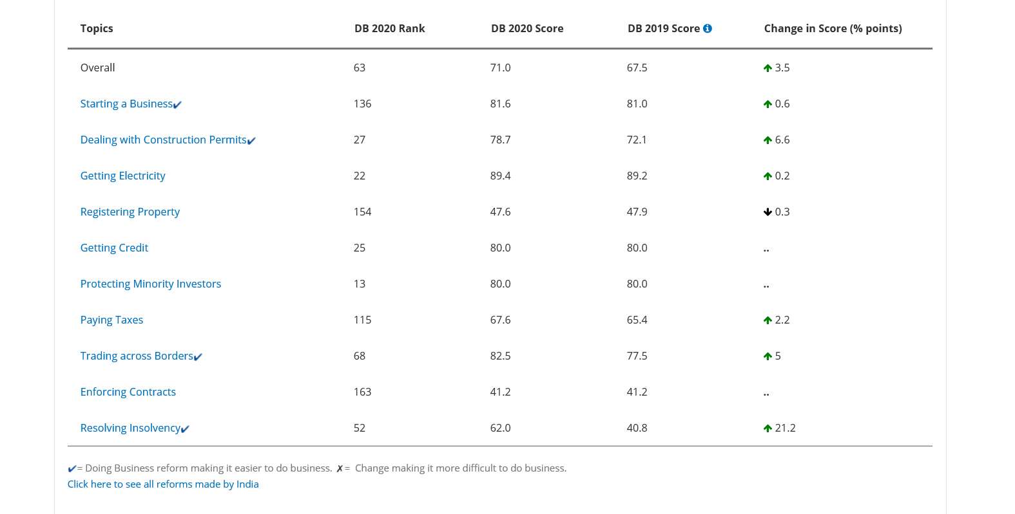
„Ease of Doing Business in India“ Index WorldBank
https://www.doingbusiness.org/en/data/exploreeconomies/india# / abgerufen 25.10.19

Slide 4

CoMMENTS
Law
Enforcement
INSOLVENCY &
Bankruptcy LAW
LaBour LAws
SETTING Up
Corporate
GOVERNACE
Centralised and digital process
Fast company formation
Required tax registrations are done now parallel with the incorporation process
Slow process for the foreign companies
Practical Problems
Opening a bank account
Corporate Governance und Transparency - Paradigm shift
Digital Processes and Linking (DIR 3 KYC, SBO, SMF & EMF, MSE Reporting, INC 22, FLA Returns)
Transposition related problems
ECB list of eligible lenders expanded Also the list of eligible BORROWERS widened (sales and services companies) and End use restrictions liberalized (buying land)
Non enforcement of Swiss judgments / No recognition without filing a new civil suit
Choice of law and place of jurisdiction
Arbitration and Conciliation Act, modern arbitration law and institutions available
Contract drafting under Common Law
Legally defined timelines for completion of the resolution process
Lower threshold to initiate the process
Electronic Information system about the companies in insolvency process
Continuing legal processes and further developments
Standardization and streamlining of labor laws and regulations
Codification in 4 categories (Industrial Relations, Wages, Safety and Social Security)
Introduction of Model laws and regulations
(Shop and Establishment Act)
Ease of Compliance (Portal, LIN)

Slide 5


Comments
TAX RATES
PROCEDURES
Cross-Border
Local Content
RULE OF LAW
Reduction in Tax rates to 25%.
Dividend Distribution Tax gains importance
Tax burden on dividends distributed Gewinns 38% (bislang 45%)
Formalities like z.B. Tax refunds and Tax payments
General attitude of the tax authorities at the lower levels
Frequent changes of the civil officers
ITAT is the first fair instance
Long duration of proceedings
High consultancy fees for our clients
NOT OECD member
Foreign Companies are in focus
New fundamental principles regarding taxation of permanent establishments
Unclarity in regulations regarding registration obligations and options
„Make in India“
Standard guidelines lacking details
Local sales requires registrations carrying wide tax implications
Transparent and comprehensible judgements
Hígh Courts und Supreme Court als „Correction“ instances
Security for the investors and suppliers

Slide 6
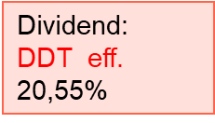
Corporate Tax - Tax Rates
Tax rates
Income tax | 25 %
Surcharge &
Health & Education Cess (B+C)
Income Tax total | 25,17%
Foreign Company | Rate
Income Tax | 40%
Surcharge | 12 %
Health & Education Cess | 4 %
Total | 43,68 %
Base
Worldwide Business Income
Shareholders
Offshore
Equity
Income Tax: 25,17%
Pvt. Ltd.
India
Notes:
Berechnungsgrundlage
1. Steuersatz indische Körperschaft
2a. Aufschlag auf (1)*
2b. Aufschlag auf (1)**
3. Ausbildungsabgabe auf (1) und (2)
4. Income Tax gesamt **

Slide 7


Contact
SEEMA BHARDWAJ LL.M. (Germany)
Attorney at Law (INDIA)
INDIA DESK, Berlin
T +49 30 810 795 53
M +49 175 585 3895
seema.bhardwaj@roedl.com
SPOT ON
Are you India-ready?
1:1 INDIA FIT SEMINARS
IN OUR OFFICES
pune@roedl.com
As an integrated professional services firm, Rödl & Partner is active at 111 wholly-owned locations in 50 countries. Our clients trust 4,900 colleagues and entrepreneurial minded partners in the globally provi- ded service lines.
Your contact persons
Germany Nuremberg Martin Wörlein
T + 49 911 9193 3010
martin.woerlein@roedl.com
India
Delhi / Ahmedabad
Neha Sharma
T +91 124 6749 701
neha.sharma@roedl.com
Berlin
Mumbai / Pune / Chennai / Bangalore
Rahul Oza
T + 91 20 6625 7100
Seema Bhardwaj
T + 49 30 8107 9553
www.roedl.de/indien
seema.bhardwaj@roedl.com rahul.oza@roedl.com

Slide 8
Verfasser:
Rödl Rechtsanwaltsgesellschaft
Steuerberatungsgesellschaft mbH
Äußere Sulzbacher Straße 100
904891 Nürnberg
- Im Folgenden kurz „Rödl & Partner“ -
Copyright:
Rödl & Partner / Deutschland - Alle Rechte vorbehalten.
Die Wiedergabe, Vervielfältigung, Verbreitung und/oder Bearbeitung sämtlicher Inhalte und Darstellungen des Beitrages sowie jegliche sonstige Nutzung ist nur mit vorheriger schriftlicher Zustimmung von Rödl & Partner gestattet.
Alle Angaben wurden sorgfältig zusammengestellt und ergänzend recherchiert.
Es wird - auch seitens der jeweiligen Autoren – keine Gewähr und somit auch keine Haftung für die Richtigkeit, Aktualität und Vollständigkeit der Inhalte und Darstellungen übernommen.
Diese Präsentation ersetzt keine Steuerberatung.

